Slide 1

BLIND NIGHT-TIME IMAGE QUALITY ASSESSMENT USING ACTIVE INFERENCE
SUBMITTED BY
ABINAYA .M.N -2018506004
DIVYA DARSHINI .K -2018506029
KAMALNATH .K.N -2018506044
UNDER THE GUIDANCE OF :
PROFESSOR DR. DHANANJAY KUMAR (HOD)
ASSOCIATE PROFESSOR DR. RADHA SENTHIL KUMAR

Slide 2
INTRODUCTION
Blind image quality assessment (BIQA) aims to develop quantitative measures to automatically and accurately estimate the visual quality of an image without any prior information about its reference image. It is a promising idea to design BIQA methods by mimicking the working mechanism of human visual system (HVS). BIQA models also need to be specially trained when dealing with Night-time captured images/video streams

Slide 3
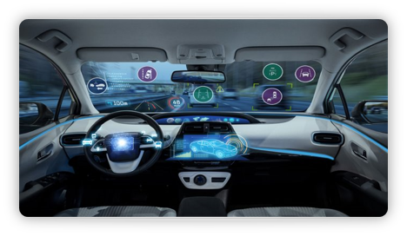




PROBLEM STATEMENT
In case of input images that do not have/that have lost source images/reference images, image quality assessment becomes a problem. For this purpose blind image quality assessment is used.
Image quality assessment is done to make decisions on the images with higher quality as well as for the purpose of reinforcement learning in the case of real time image processing system.
BIQA models are constantly being improved to bridge the gap between them and Human Visual Systems. Therefore in our project we aim to optimise a BIQA model that uses active inference(our base paper) for the purpose of night time image quality assessments.

Slide 4
BLIND IMAGE QUALITY ASSESSMENT WITH ACTIVE INFERENCE(BASE PAPER)
Firstly, an active inference module based on the generative adversarial network (GAN) is established to predict the primary content, in which the semantic similarity and the structural dissimilarity are both considered during the optimization.
Then, the image quality is measured on the basis of its primary content. Generally, the image quality is highly related to three aspects, i.e., the scene information ,the distortion type (distortion-dependency), and the content degradation.
According to the correlation between the distorted image and its primary content, the three aspects are analyzed and calculated respectively with a multi-stream convolutional neural network (CNN) based quality evaluator.
https://github.com/jerryjasmine/referencepaper/blob/main/Blind_Image_Quality_Assessment_With_Active_Inference.pdf

Slide 5
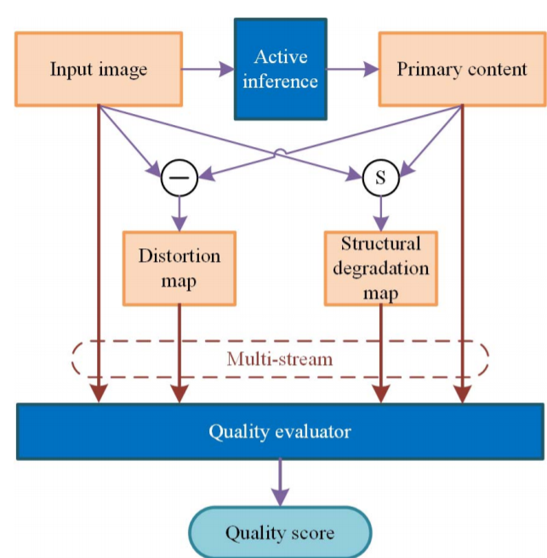

Slide 6
LITERATURE SURVEY

Slide 7
BLIND NIGHT-TIME IMAGE QUALITY ASSESSMENT: SUBJECTIVE AND OBJECTIVE APPROACHES
First, they build a large-scale natural night-time image database (NNID) containing 2240 images with 448 different image contents captured by different photographic equipment in real-world scenarios. Subsequently, they carry out a subjective experiment to evaluate the perceptual quality of all the images in the NNID database.
Finally, extensive experiments are conducted to evaluate the performance and efficiency of the proposed BNBT metric on the NNID database.
https://github.com/jerryjasmine/referencepaper/blob/main/1%20Blind_Night-Time_Image_Quality_Assessment_Subjective_and_Objective_Approaches.pdf

Slide 8
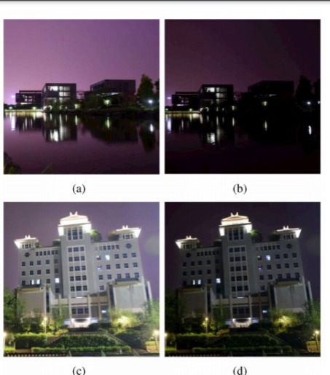

Slide 9
BLIND IMAGE QUALITY ASSESSMENT OF NATURAL DISTORTED IMAGE BASED ON GENERATIVE ADVERSARIAL NETWORKS
In this work, we propose a blind image quality assessment based on generative adversarial network (BIQA-GAN) with its advantages of self-generating samples and self-feedback training to improve network performance.
Three different BIQA-GAN models are designed according to the target domain of the generator.

Slide 10
BLIND IMAGE QUALITY ASSESSMENT: FROM NATURAL SCENE STATISTICS TO PERCEPTUAL QUALITY
Their approach to blind image quality assessment (IQA) is based on the hypothesis that natural scenes possess certain statistical properties which are altered in the presence of distortion, rendering them un-natural; and that by characterizing this un-naturalness using scene statistics, one can identify the distortion afflicting the image and perform no-reference (NR) IQA.
we propose an (NR)/blind algorithm—the Distortion Identification-based Image Verity and INtegrity Evaluation (DIIVINE) index—that assesses the quality of a distorted image without need for a reference image.
In this paper, they detail the principles underlying DIIVINE, the statistical features extracted and their relevance to perception and thoroughly evaluate the algorithm on the popular LIVE IQA database

Slide 11
NO-REFERENCE IMAGE SHARPNESS ASSESSMENT IN AUTOREGRESSIVE PARAMETER SPACE
This model is established via the analysis of AR model parameters, first calculating the energy- and contrast-differences in the locally estimated AR coefficients in a pointwise way, and then quantifying the image sharpness with percentile pooling to predict the overall score
In addition to the luminance domain, they further consider the inevitable effect of color information on visual perception to sharpness and thereby extend the above model to the widely used YIQ color space.
https://github.com/jerryjasmine/referencepaper

Slide 12
MC360IQA: A MULTI-CHANNEL CNN FOR BLIND 360-DEGREE IMAGE QUALITY ASSESSMENT
In this paper, they present a study on both subjective and objective quality assessment of compressed virtual reality (VR) images.
We first build a compressed VR image quality (CVIQ) database including 16 reference images and 528 compressed ones with three prevailing coding technologies. Then, we propose a multi-channel convolution neural network (CNN) for blind 360-degree image quality assessment (MC360IQA).
To be consistent with the visual content seen in the VR device, we project each 360-degree image into six viewport images, which are adopted as inputs of the proposed model. MC360IQA consists of two parts, a multi-channel CNN and an image quality regressor
The image quality regressor fuses the features and regresses them to final scores.

Slide 13
CONCLUSION
Our objective is to further the BIQA model that uses active inference and extend it for the purpose of qualitative assessment of Night-Time Images, that aids the working/set-up of real time automated image processing systems such as automated cars

